Slide 1

Defence Research and Development Organisation(DRDO)
Presented by:
Dibya Dipanjan NIT Rourkela

Slide 2
About DRDO
The DRDO is the agency under the Department of Defence Research and Development in the Ministry of Defence of the Government of India, charged with the military's research and development, headquartered in Delhi, India.
It was formed in 1958 by the merger of the Technical Development Establishment and the Directorate of Technical Development and Production of the Indian Ordnance Factories with the Defence Science Organisation.
DRDO started its first major project in surface-to-air missiles (SAM) known as Project Indigo in the 1960s. Indigo was discontinued in later years without achieving full success. Project Indigo led to Project Devil, along with Project Valiant, to develop short-range SAM and Intercontinental Ballistic Missile(ICBM) in the 1970s.

Slide 3
Project Devil itself led to the later development of the Prithvi missile under the Integrated Guided Missile Development Programme (IGMDP) in the 1980s. IGMDP was an Indian Ministry of Defence programme between the early 1980s and 2007 for the development of a comprehensive range of missiles, including the Agni missile, Prithvi ballistic missile, Akash missile, Trishul missile and Nag Missile.
The key measures to make DRDO effective in its functioning include the establishment of a Defence Technology Commission with the defence minister as its chairman.
The programmes which were largely managed by DRDO have seen considerable success with many of the systems seeing rapid deployment as well as yielding significant technological benefits. Since its establishment, DRDO has created other major systems and critical technologies such as aircraft avionics, UAVs, small arms, artillery systems, EW Systems, tanks and armoured vehicles, sonar systems, command and control systems and missile systems.

Slide 4
ABOUT PXE
The Proof and Experimental Establishment (PXE) is an Indian defence laboratory of the Defence Research and Development Organisation (DRDO). Located in Balasore, Orissa, India. its main purpose concerns the research and development of technologies and products in the area of medium and large caliber weapons and their ammunition. PXE is organised under the Armament and Combat Engineering Cluster of DRDO.
It is situated on the coast of Bay of Bengal at Chandipur , in Odisha, at a distance of 15 km from Balasore city. This is the oldest establishment of DRDO. It was established by a Government Order of May 30, 1895. The first firing activity took place on 07 Nov 1895

Slide 5
PXE is the main non-Army Proving ground and research establishment for design and developmental trials of guns, mortars, rockets, RCL, tank guns and their ammunition, including Naval guns and ammunition. It also conducts technical evaluation trials for imported weapons and ammunition as well as R&A trials for compilation of Range Tables.
PXE also conducts performance evaluation trials for tank armour and ammunition, as well as proof of armour plates, tank turrets, ICVs, proximity fuzes, etc. and also weapons and ammunition produced by the Indian Ordnance Factories. PXE has conducted tests of the Arjun MBT Armour as well as tests of indigenous Explosive reactive armour. The lab has also conducted tests of other armaments such as the Indian Field Gun and the Pinaka Multi Barrel Rocket Launcher System.

Slide 6
Projects and products of PXE
Established high speed photography techniques for study of sabot discarding phenomena in sub caliber projectile.
Spin measurement of projectiles by Doppler Radar and High Speed Photography Technique.
Measurement of Height of Burst of Proximity fuze by Photography technique.
Easy and faster method of barrel changing in T-72 Tanks.
Recovery technique of fired projectiles both over water and over wet sand.
Recording of full trajectory data of artillery projectiles

Slide 7
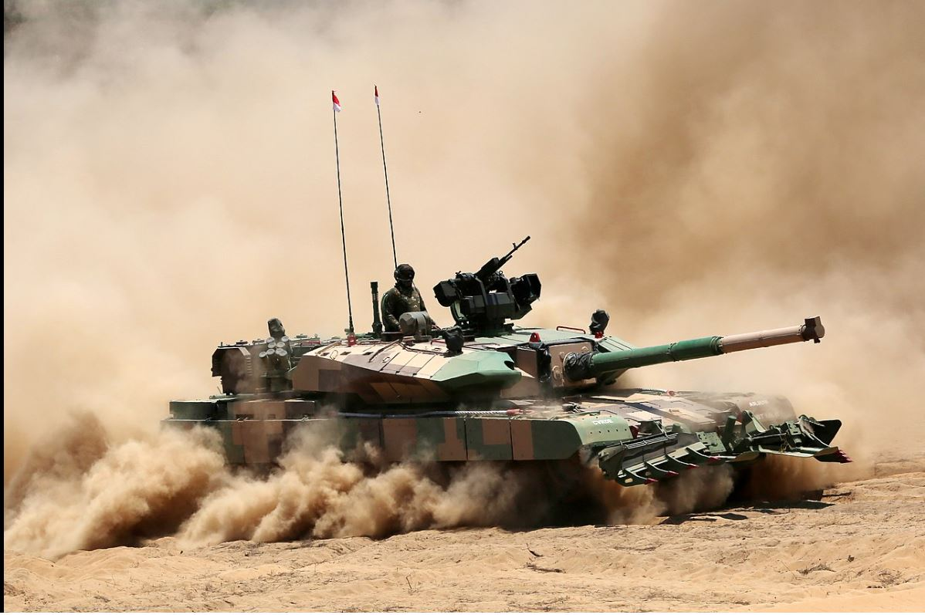
MBT ARJUN
The Arjun is a third generation main battle tank developed by the Combat Vehicles Research and Development Establishment (CVRDE) of the Defence Research and Development Organisation (DRDO), for the Indian Army.
The tank is named after Arjuna, the archer prince who is the main protagonist of the Indian epic poem Mahabharata.
The main working of design was started in 1986 and was completed by 1996.

Slide 8
Features
The Arjun features a 120 mm rifled main gun with indigenously developed armour-piercing fin-stabilized discarding-sabot ammunition.
One PKT 7.62 mm coaxial machine gun.
A NSVT of 12.7mm machine gun.
When powered by a single MTU multi-fuel diesel engine rated at 1,400 hp, it can achieve a maximum speed of 70 km/h and a cross-country speed of 40 km/h.
It has a four-man crew: commander, gunner, loader and driver.

Slide 9
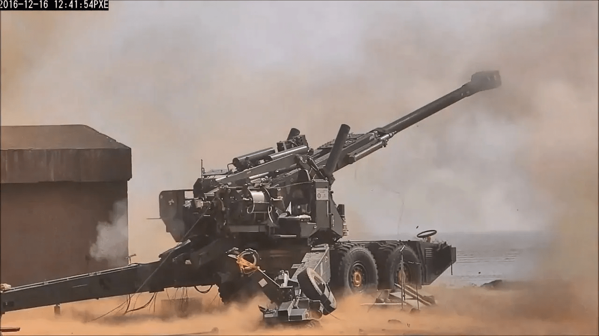
Advanced Towed Artillery Gun System ( ATAGS )
The ATAGS (Advanced Towed Artillery Gun System) is a towed 155 mm/52 calibre howitzer developed by the Defence Research and Development Organisation (DRDO) for the Indian Army and manufactured by Bharat Forge and Tata Power SED.
The Advanced Towed Artillery Gun System (ATAGS) project was started in 2013 by DRDO to replace older guns in service in the Indian Army with a modern 155mm artillery gun.

Slide 10
Features
The gun has a barrel, breech mechanism, muzzle brake, and recoil system and can fire 155 mm calibre ammunition with a range of 48 kilometres.
It has an all-electric drive to ensure reliability and minimum maintenance over a long period of time.
It has advanced features like high mobility, quick deployability, auxiliary power mode, advanced communication system, automatic command and control system with night capability in direct-fire mode.
The gun is two tons lighter than guns in the same category and is designed to provide better accuracy and range and is capable of firing five successive rounds in short duration.
It is compatible with C3I systems like Artillery Combat Command and Control System (ACCCS) called Shakti for technical fire control, fire planning, deployment management, operational logistics management of the Indian Army

Slide 11
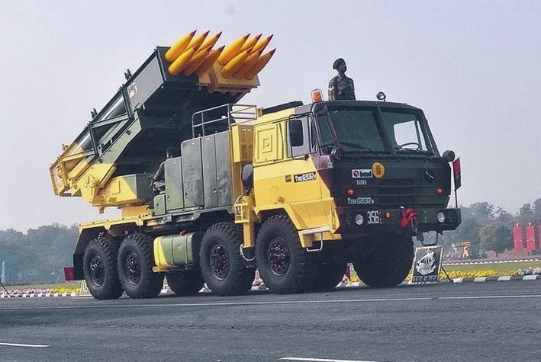
PINAKA ROCKET SYSTEM
Pinaka is a multiple rocket launcher produced in India and developed by the Defence Research and Development Organisation (DRDO) for the Indian Army.
The system has a maximum range of 40 km for Mark-I and 60 km for Mark-I enhanced version, and can fire a salvo of 12 HE rockets in 44 seconds.
The system is mounted on a Tatra truck for mobility. Pinaka saw service during the Kargil War, where it was successful in neutralising enemy positions on the mountain tops.
It has since been inducted into the Indian Army in large numbers.

Slide 12
Features
Each Pinaka battery consists of : six launcher vehicles.
Each launcher vehicle have – 1) 12 rockets
2) Six loader replenishment vehicles.
3) Three replenishment vehicles.
4) Two Command Post vehicle( 1 on stand by )
5) The DIGICORA MET radar
The Army generally deploys a battery that has a total of 72 rockets. All of the 72 rockets can be fired in 44 seconds, taking out an area of 1 km2.
Fire Control Computer gives the system flexibility to fire all the rockets in one go or only a few.
Total operational time optimised for shoot & scoot capability.

Slide 13
Modes of Operation
Autonomous mode: The launcher is fully controlled by a fire control computer (FCC). The microprocessor on the launcher automatically executes the commands received from the FCC, giving the operator the status of the system on displays and indicators.
Stand-alone mode: In this mode, the launcher is not linked to the FCC operator, and the operator at the console enters all the commands for laying of the launcher system and selection of firing parameters.
Remote mode: In this mode, a remote control unit carried outside the cabin up to a distance of about 200 m can be used to control the launcher system, the launcher site and to unload the fired rocket pods from the launcher.
Manual mode: All launcher operations including laying of the system and firing are manually controlled. This mode is envisaged in the situations where the microprocessor fails or where there is no power to activate the microprocessor-based operator's console.

Slide 14
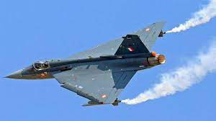
Light Combat Aircraft(LCA)
A light combat aircraft (LCA) is a light, multirole jet military aircraft, commonly derived from advanced trainer designs, designed for engaging in light combat.
The mission can either be in a light strike or attack missions, reconnaissance, interdiction roles or trainer roles.
They are typically slower than larger multirole or strike aircraft such as the American F-18, F-15E Strike Eagle, or Russian MiG-29.
Most light combat aircraft are capable only of subsonic speeds, although some are capable of reaching Mach 1+. An LCA will typically be equipped with bombs, gun pods, or short-range air-to-air missiles used for COIN or CAS missions.

Slide 15
Features
It's a single-engine multirole combat aircraft with a tailless compound delta wing with "relaxed static stability.“
In a single mission, the Tejas may perform interception, air-to-surface, and anti-shipping missions.
Tejas features eight hardpoints, including one beneath the port-side air intake, one under the fuselage (centreline station), and three under each wing, three of which are wet hardpoints capable of carrying drop tanks. Sensor pods like as FLIR, IRST, or laser rangefinder/designator are carried on the hardpoint beneath the port side air-intake. These can also be carried on the inboard pairs of wing stations and the centreline pylon.
Under the starboard side air intake, the Tejas carries an internal 23 mm Gryazev-Shipunov GSh-23 twin-barreled autocannon.
Refueling aircraft in the air, air-to-ground weapons, and more Capabilities of Visual Range Missiles

Slide 16
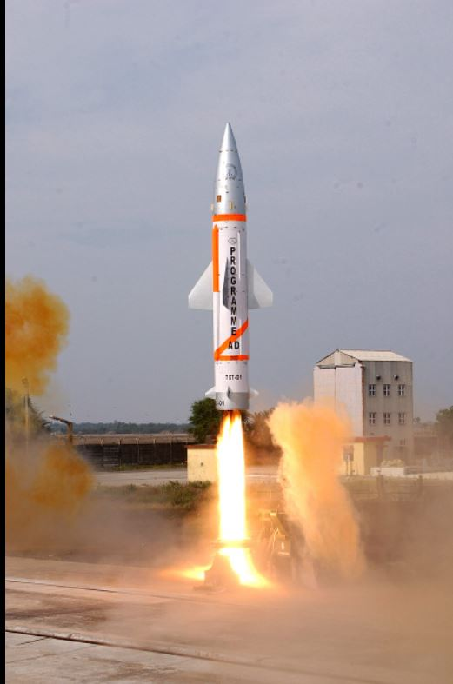
PRITHVI AIR DEFENCE (PAD)
The Prithvi Air Defence (PAD) is an anti-ballistic missile developed to intercept incoming ballistic missiles outside the atmosphere (exo-atmospheric).
Based on the Prithvi missile, PAD is a two-stage missile with a maximum interception altitude of 80 km (50 mi). The first stage is a Solid fuelled motor while the second stage is Liquid fuelled.
It has manoeuvre thrusters which can generate a lateral acceleration of more than 5 gs at 50 km (31 mi) altitude. Guidance is provided by an internal navigation system with mid-course updates from LRTR and active radar homing in the terminal phase.
PAD has capability to engage the 3,000 km (1,900 mi) class of ballistic missiles at a speed of Mach 5. PAD is fast enough to hit medium-range ballistic missiles and intermediate-range ballistic missiles.

Slide 17
Prithvi Air Defence Exercise
The PADE (Prithvi Air Defence Exercise) was conducted on November 2006 in which a PAD missile successfully intercepted a modified Prithvi-II Missile at an altitude of 50 km (31 mi). The Prithvi-II ballistic missile was modified successfully to mimic the trajectory of M-11 missiles.
DRDO plans to test the anti-ballistic shield against missiles with a range of 3,000 km (1,900 mi). The test will be conducted with a modified Prithvi missile launched from a naval ship and the anti-ballistic missile launched from Wheeler Island. The interception of the target missile will take place at approximately 80 km (50 mi) altitude.
On 6 March 2009 the DRDO carried out a second successful test of the PAD interceptor missile. The target used was ship launched Dhanush missile which followed the trajectory of a missile with range of a 1,500 km (930 mi). The target was tracked by Swordfish (LRTR) radar and destroyed by the PAD at 75 km (47 mi) altitude.

Slide 18
MATLAB APPLICATION –Amplitude Modulation(AM) in Time Domain

Slide 19
Code:

Slide 20
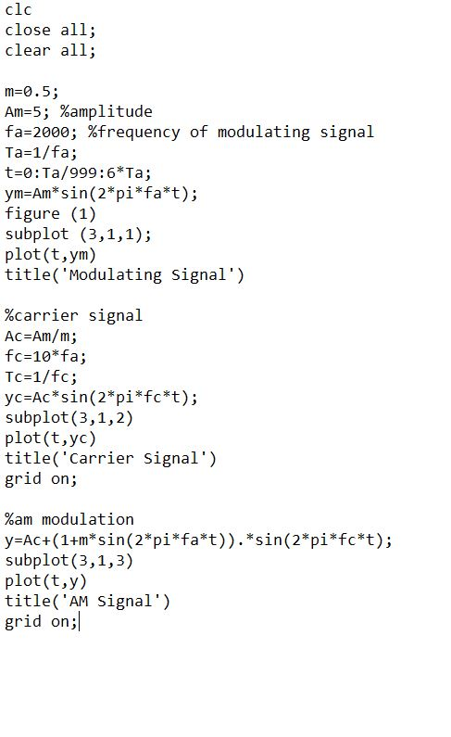

Slide 21
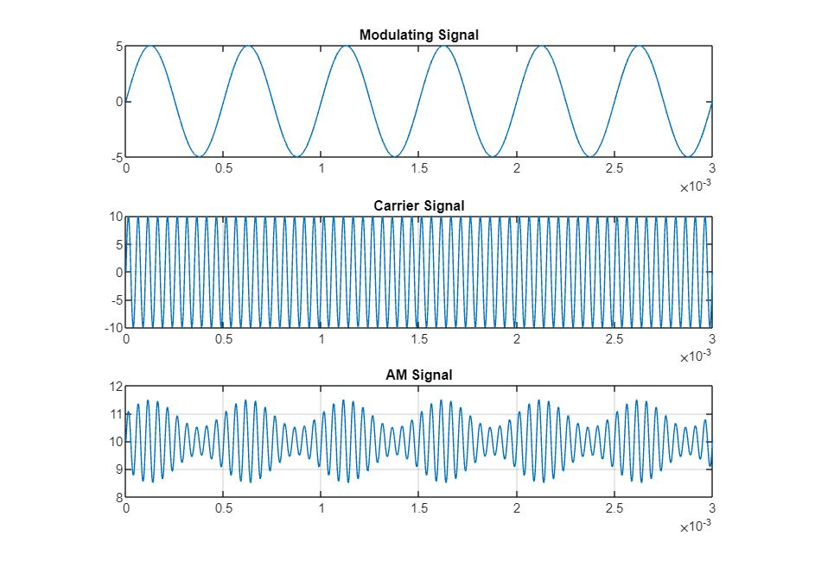
Simulation Results

Slide 22
Personal Project
Implementation of 32-BIT FLOATING POINT MULTIPLICATION USING VERILOG

Slide 23
CODE

Slide 24
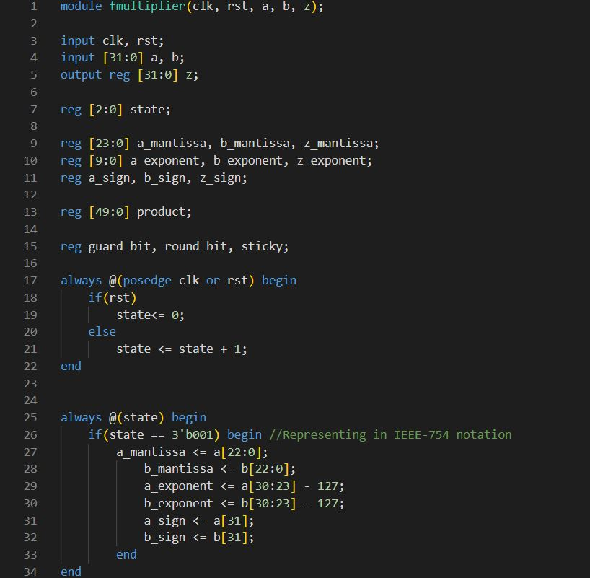

Slide 25
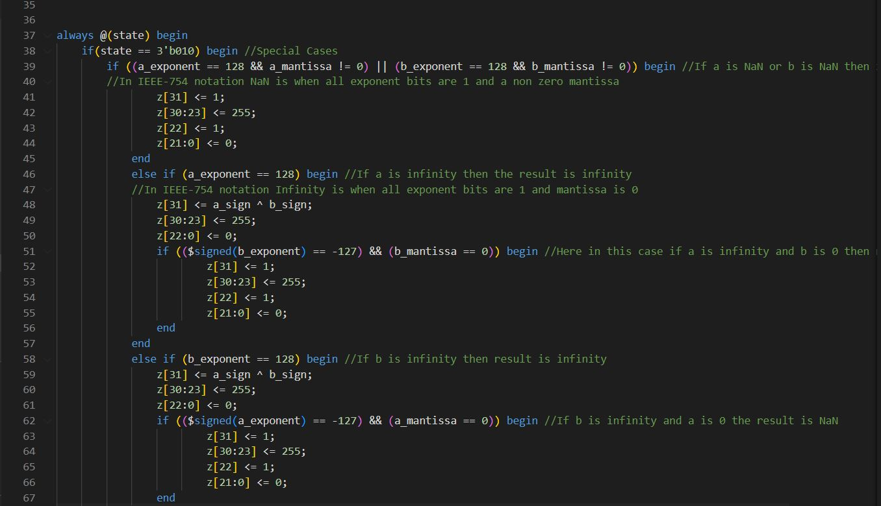

Slide 26
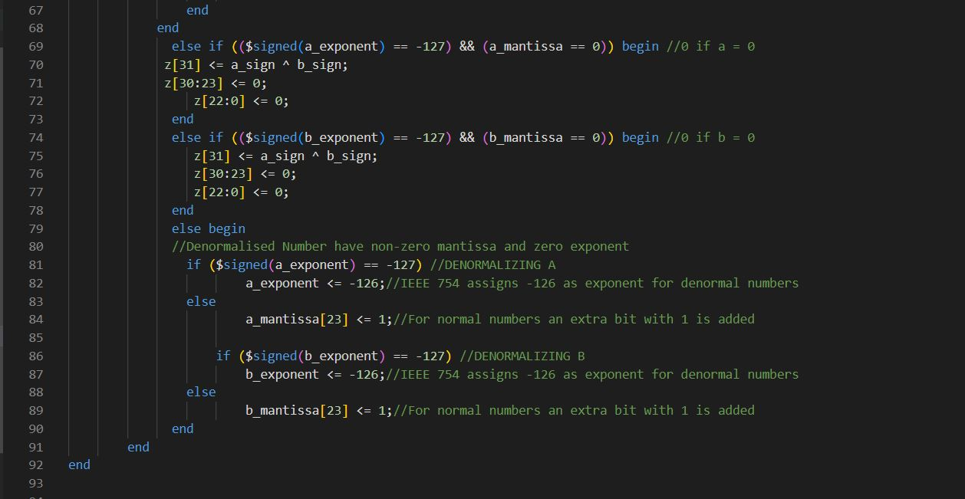

Slide 27
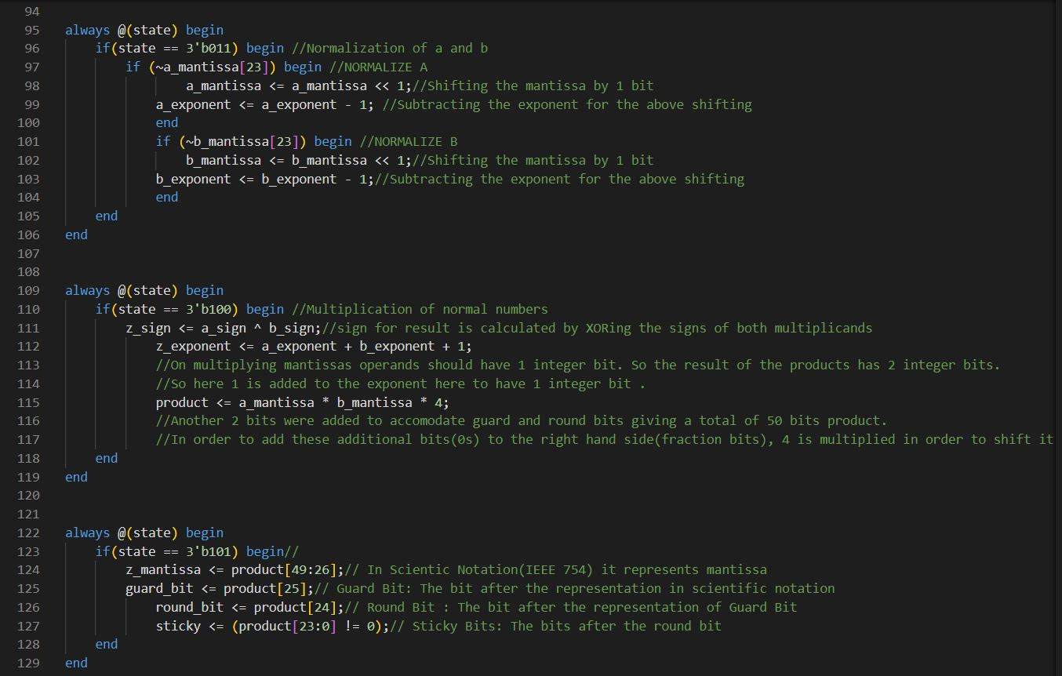

Slide 28
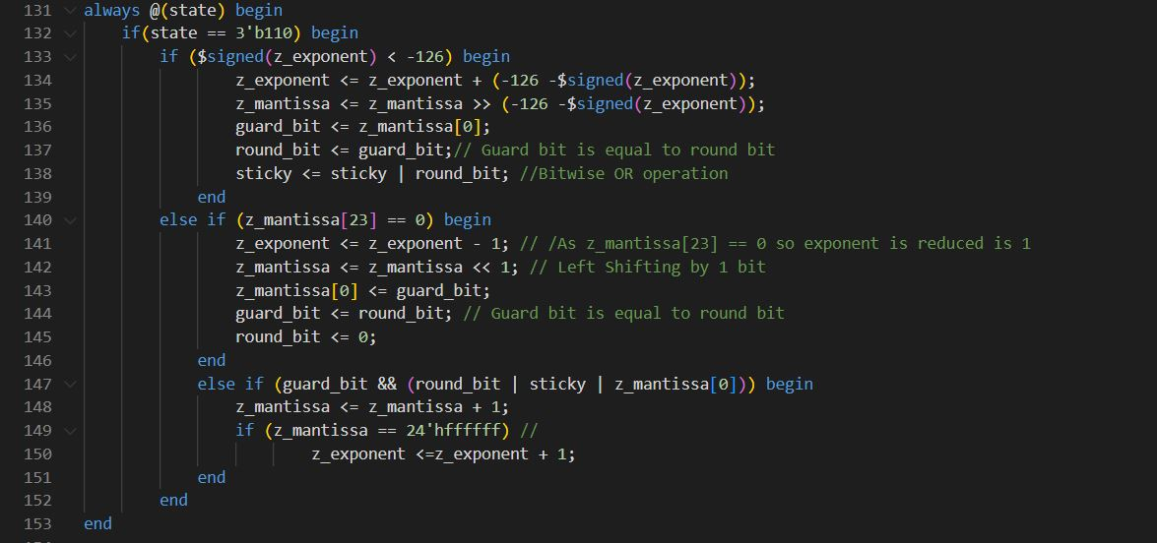

Slide 29


Slide 30
P ROJECT AT PXE,DRDO
study of rotational and translational motion by high speed imaging technique using matlab

Slide 31
Image analysis using photron fast viewer software

Slide 33
Setting up coordinates of quad in matlab

Slide 34
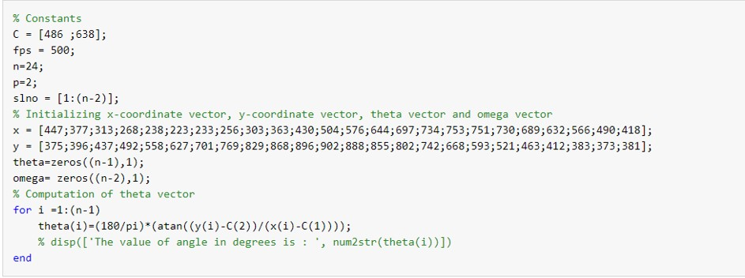

Slide 35
Code for Calculation of RPM

Slide 36
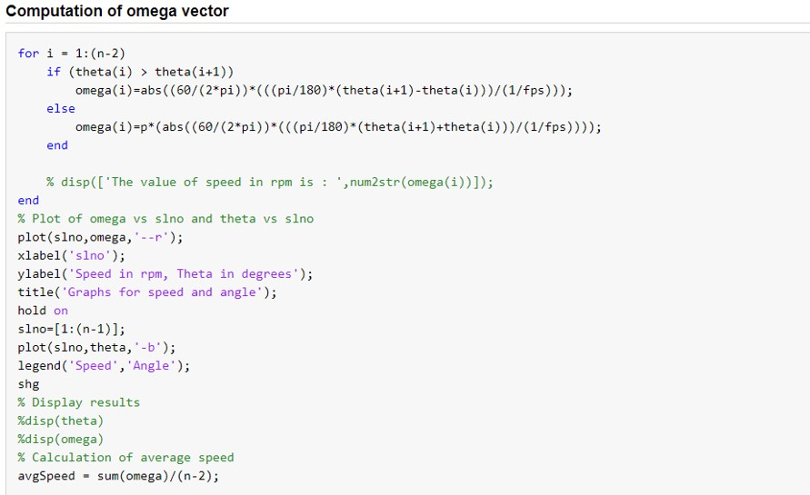

Slide 37
Variation of RPM obtained

Slide 38
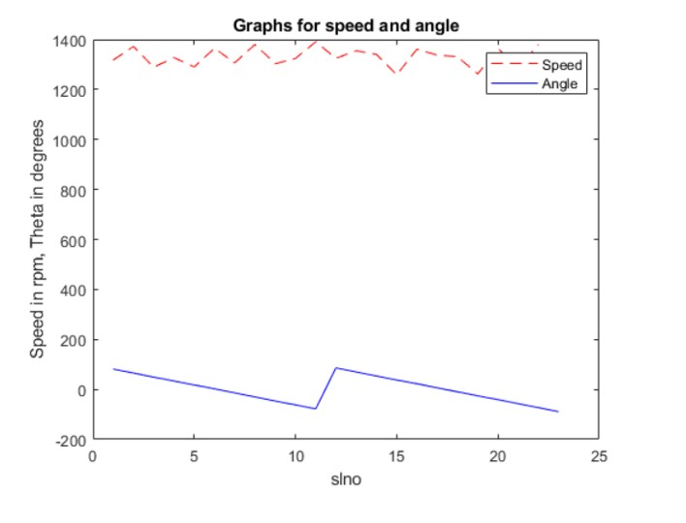

Slide 39


